Slide 1


K.RAMAKRISHNAN COLLEGE OF TECHNOLOGY
(AUTONOMOUS), TRICHY
An Edge-Optimized Multimodal System for Regional Code-Mixed Speech Emotion and Speaker Recognition
GUIDED BY
Ms. ADEEBA AAISHA F
TA /AIDS
PRESENTED BY
ABETHA M K - 2403811724322001
ACHUTHAN G K R - 2403811724321002
ADARSHINI M - 2403811724322003
HARIHARAN R - 2403811724321028

Slide 2
PRESENTATION OVERVIEW
Abstract
Objective
Architecture diagram
Existing system
Proposed system
Conclusion
Future enhancement

Slide 3
ABSTRACT
AI-based system for speaker and emotion recognition.
Handles regional code-mixed speech such as Tanglish.
Combines audio and text using multimodal processing.
Designed for real-time edge deployment with low computation.

Slide 4
OBJECTIVE
Identify the speaker from voice characteristics.
Detect the speaker's emotional state.
Understand regional code-mixed speech.
Enable fast and privacy-preserving edge processing.

Slide 5
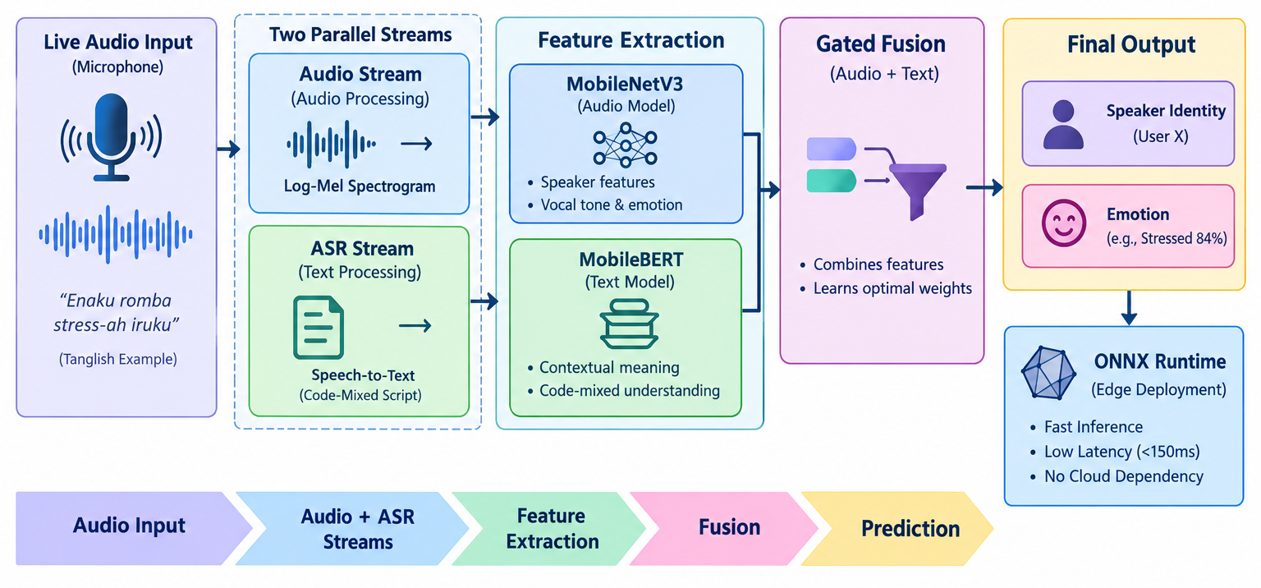
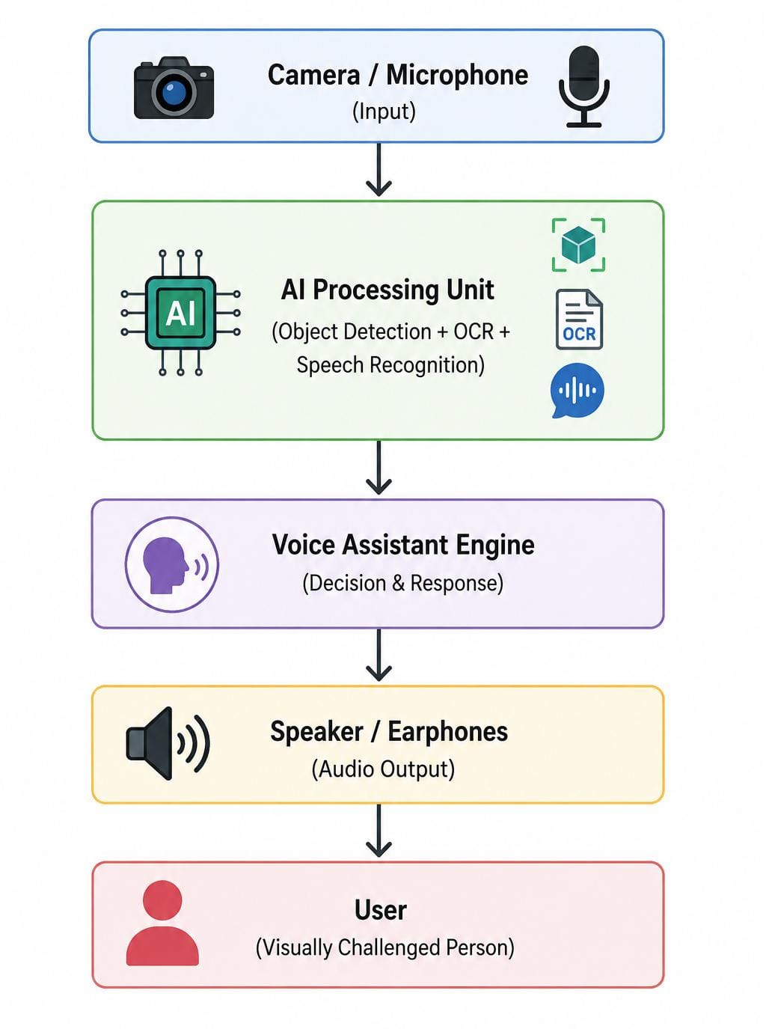
ARCHITECTURE DIAGRAM

Slide 6
EXISTING SYSTEM
Mostly supports monolingual speech.
Many systems use heavy deep learning models.
Cloud processing causes latency and dependency.
Speaker and emotion recognition are often separate tasks.

Slide 7
PROPOSED SYSTEM
Multimodal Edge-AI: Combines audio features and speech-text information for better recognition.
Lightweight Models: Uses MobileNetV3 for speaker/vocal features and MobileBERT for code-mixed emotional context.
Gated Fusion: Intelligently combines both modalities to improve emotion and speaker prediction.
Real-Time & Private: Uses ONNX Runtime for low-latency processing directly on local/edge devices without cloud dependency.

Slide 8
CONCLUSION
Combines speaker and emotion recognition in one system.
Multimodal processing improves speech understanding.
Lightweight models support edge deployment.
Local processing improves privacy and response speed.
Notes:
8

Slide 9
FUTURE ENHANCEMENT
Support more Indian regional languages.
Improve performance using larger code-mixed datasets.
Add multi-speaker detection.
Optimize models further for mobile and embedded devices.

Slide 10
THANK YOU

